Slide 1
Online Examination System

Slide 2
Important Pages
StudentRegistrationServlet : where the student can register and details get stored into the database.
TeacherRegistrationServlet : where the teacher can register and details get stored into the database.
StudentLoginServlet : Student can login if student has already registered.
TeacherLoginServlet : Teacher can login if teacher has already registered.
ValidationFilter : It is used for above files.
WelcomeExam.jsp : where the student can appear for the test.
ExamServlet : is used for calculating score.

Slide 3
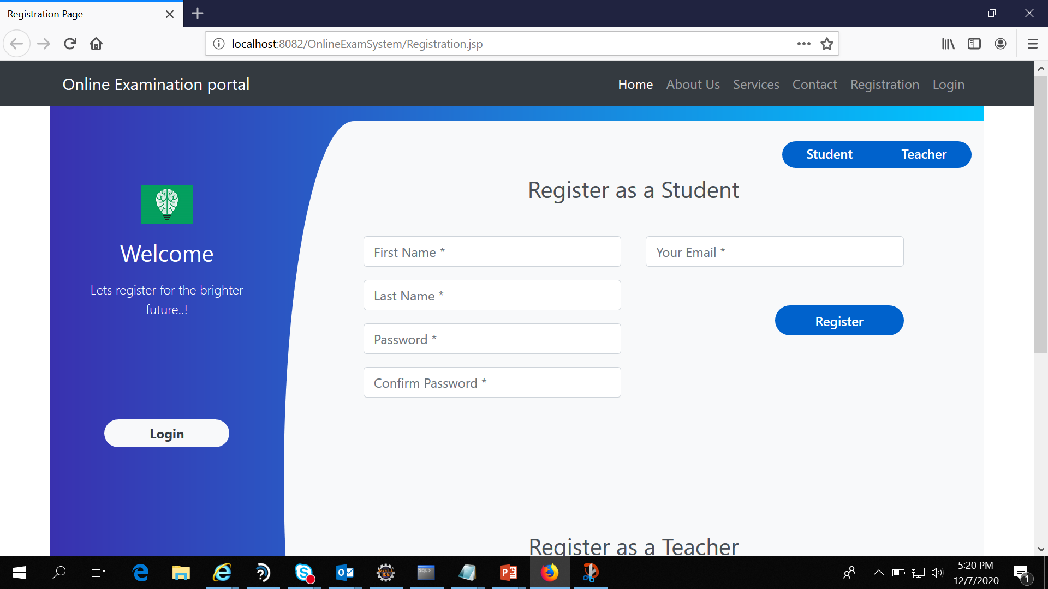
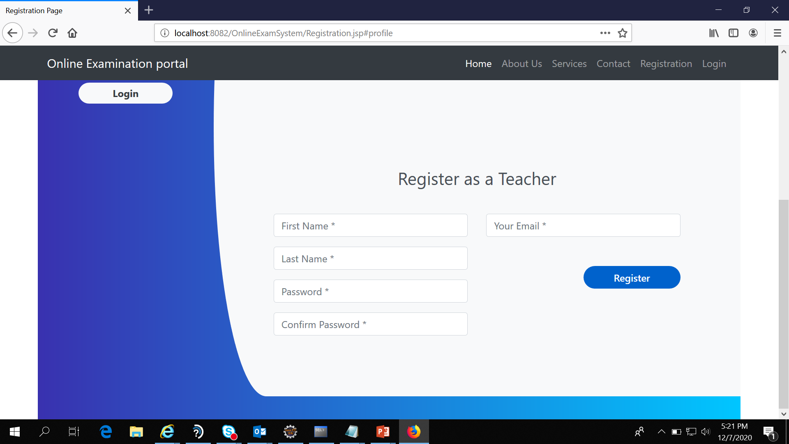
Registration Page

Slide 4
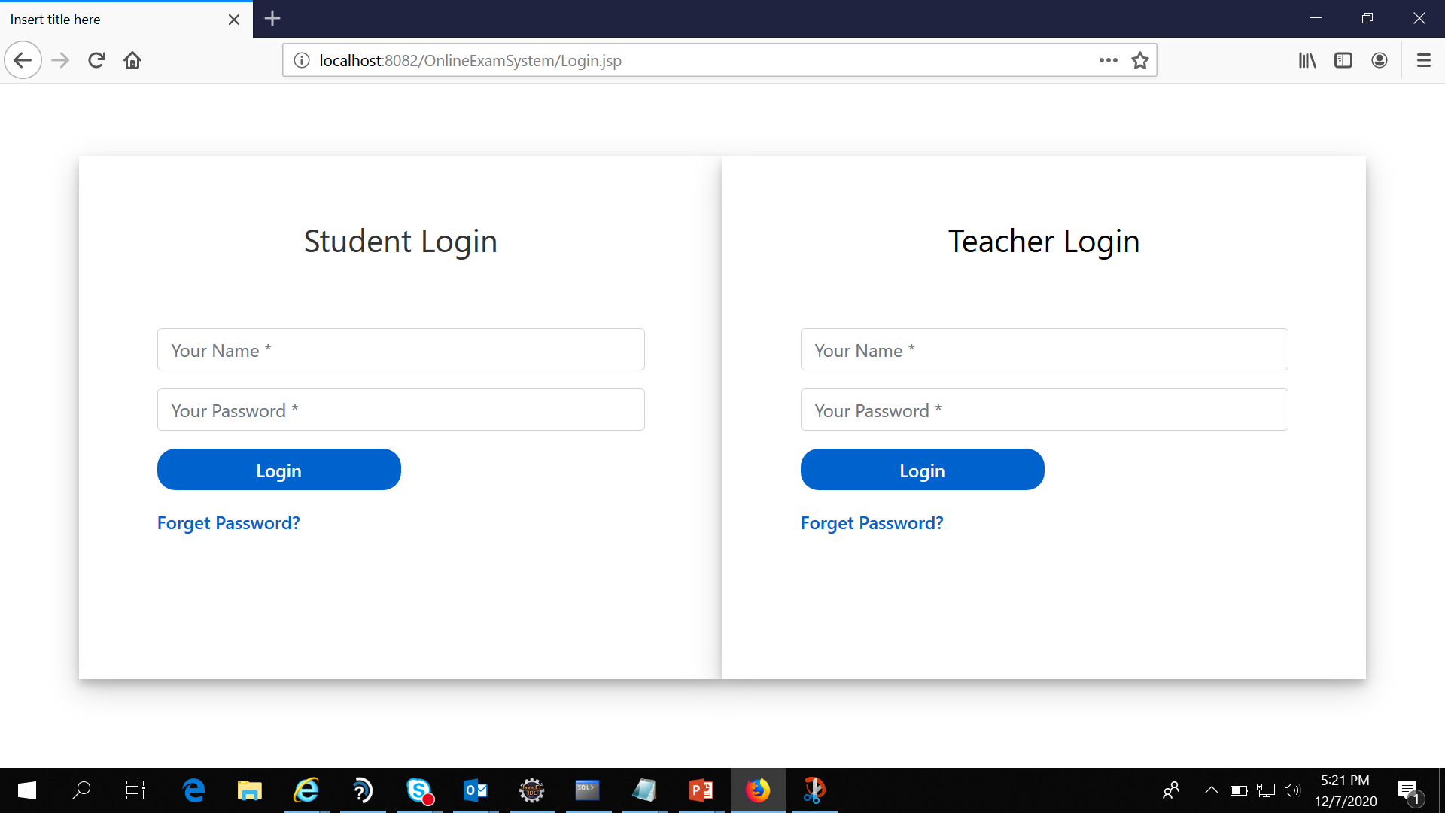
Login Page

Slide 5
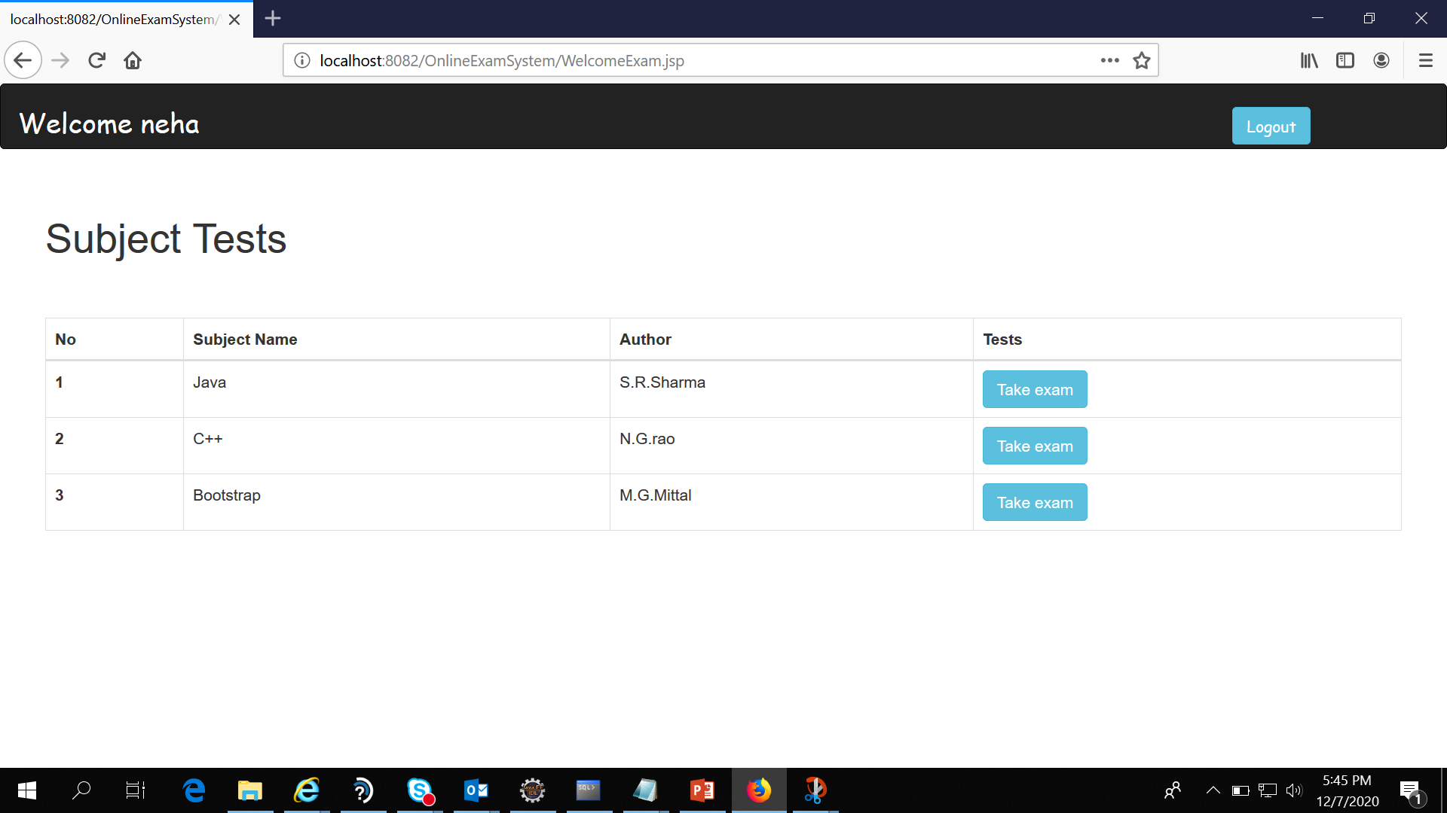
Student can give exam

Slide 6
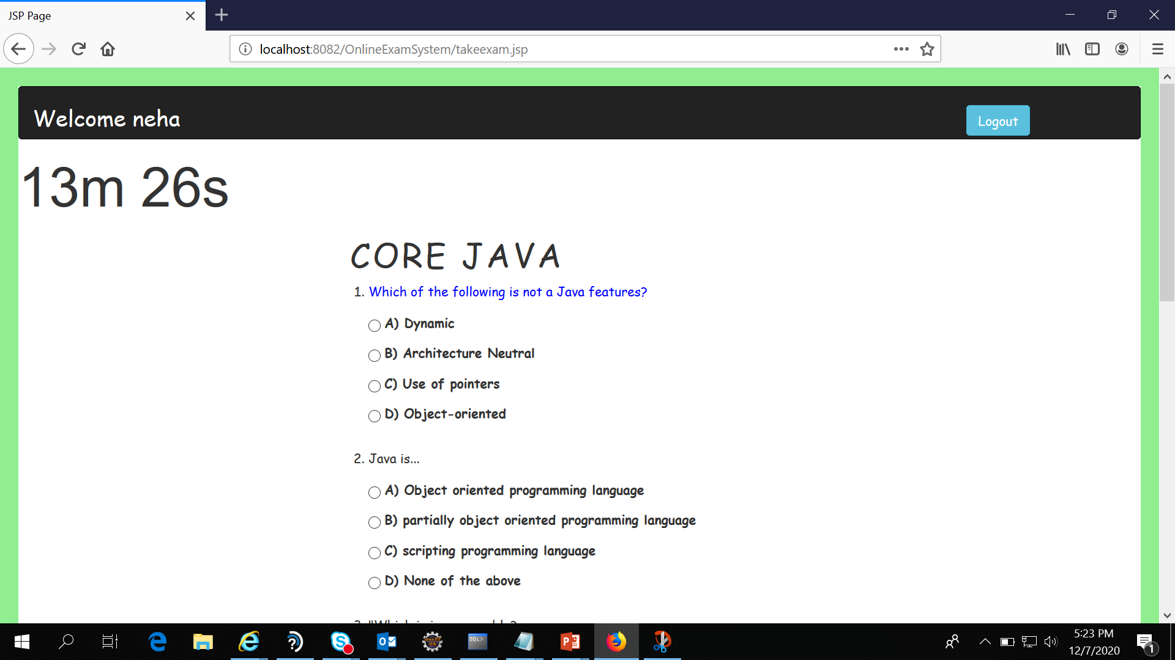

Slide 7
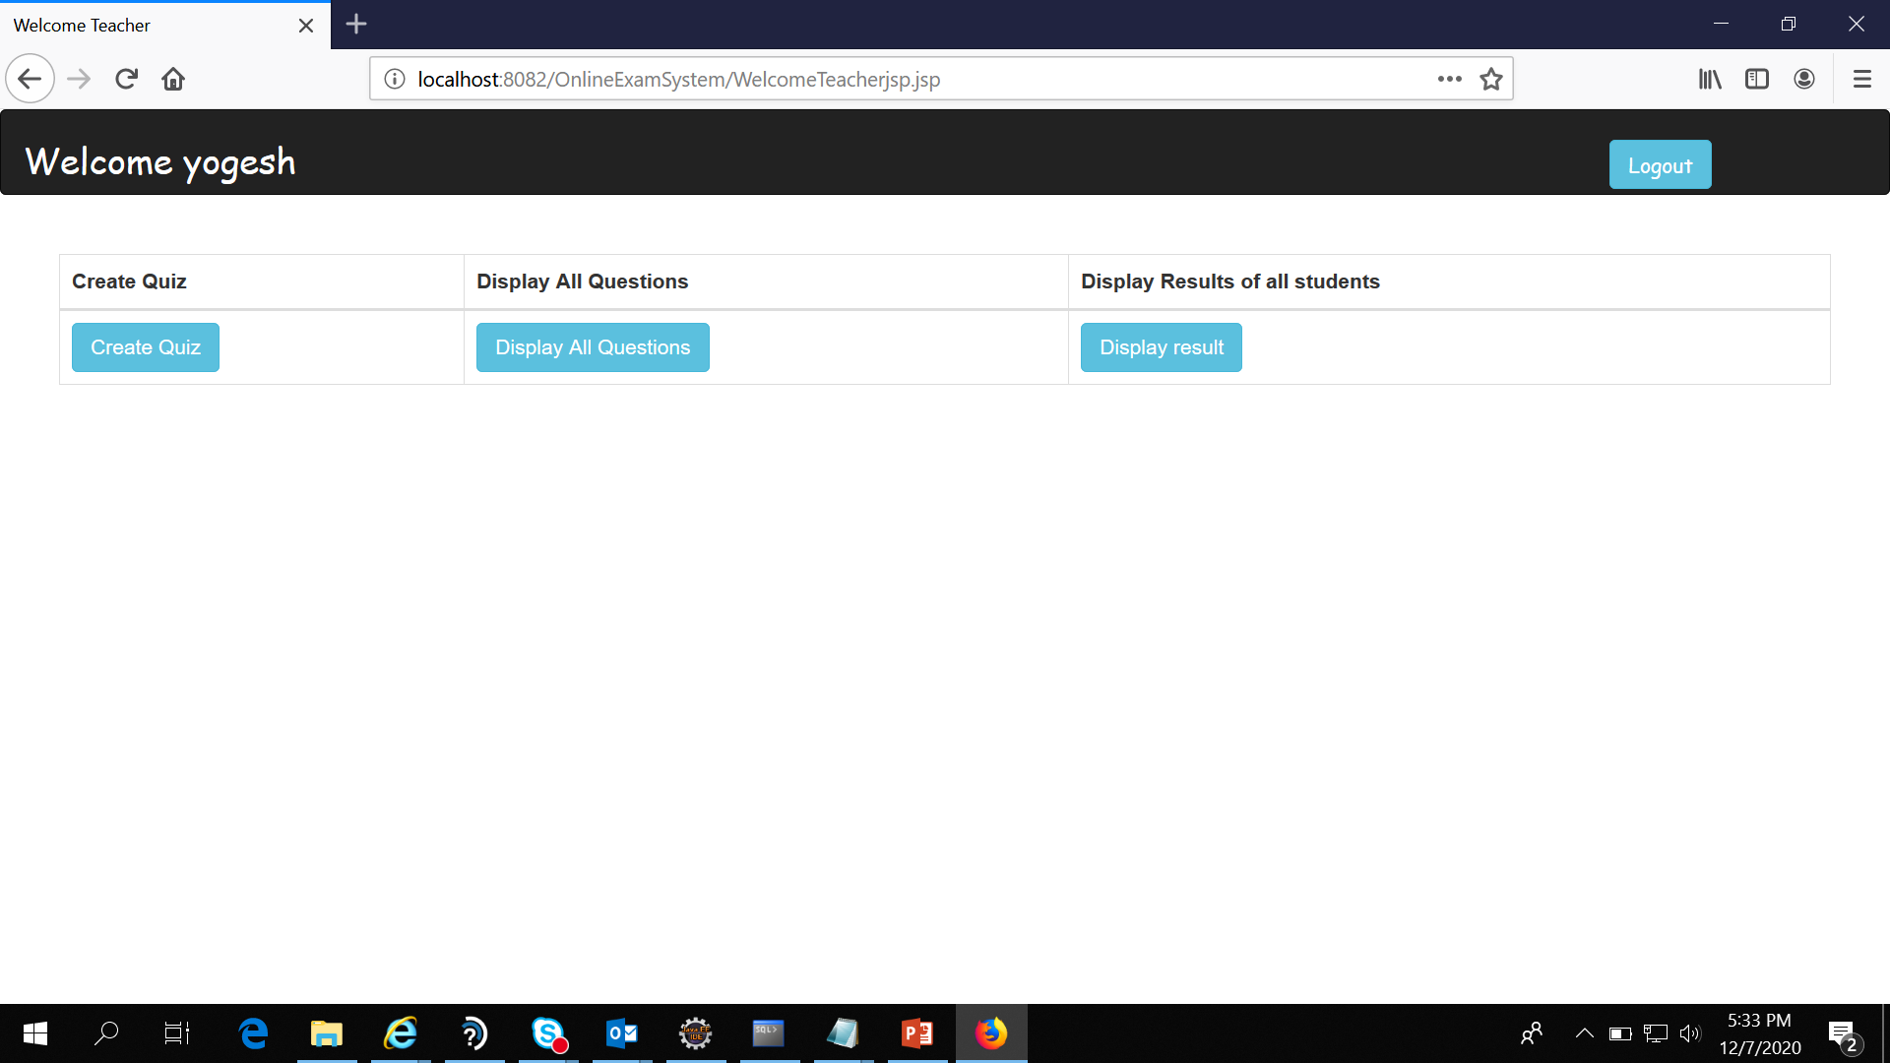

Slide 8
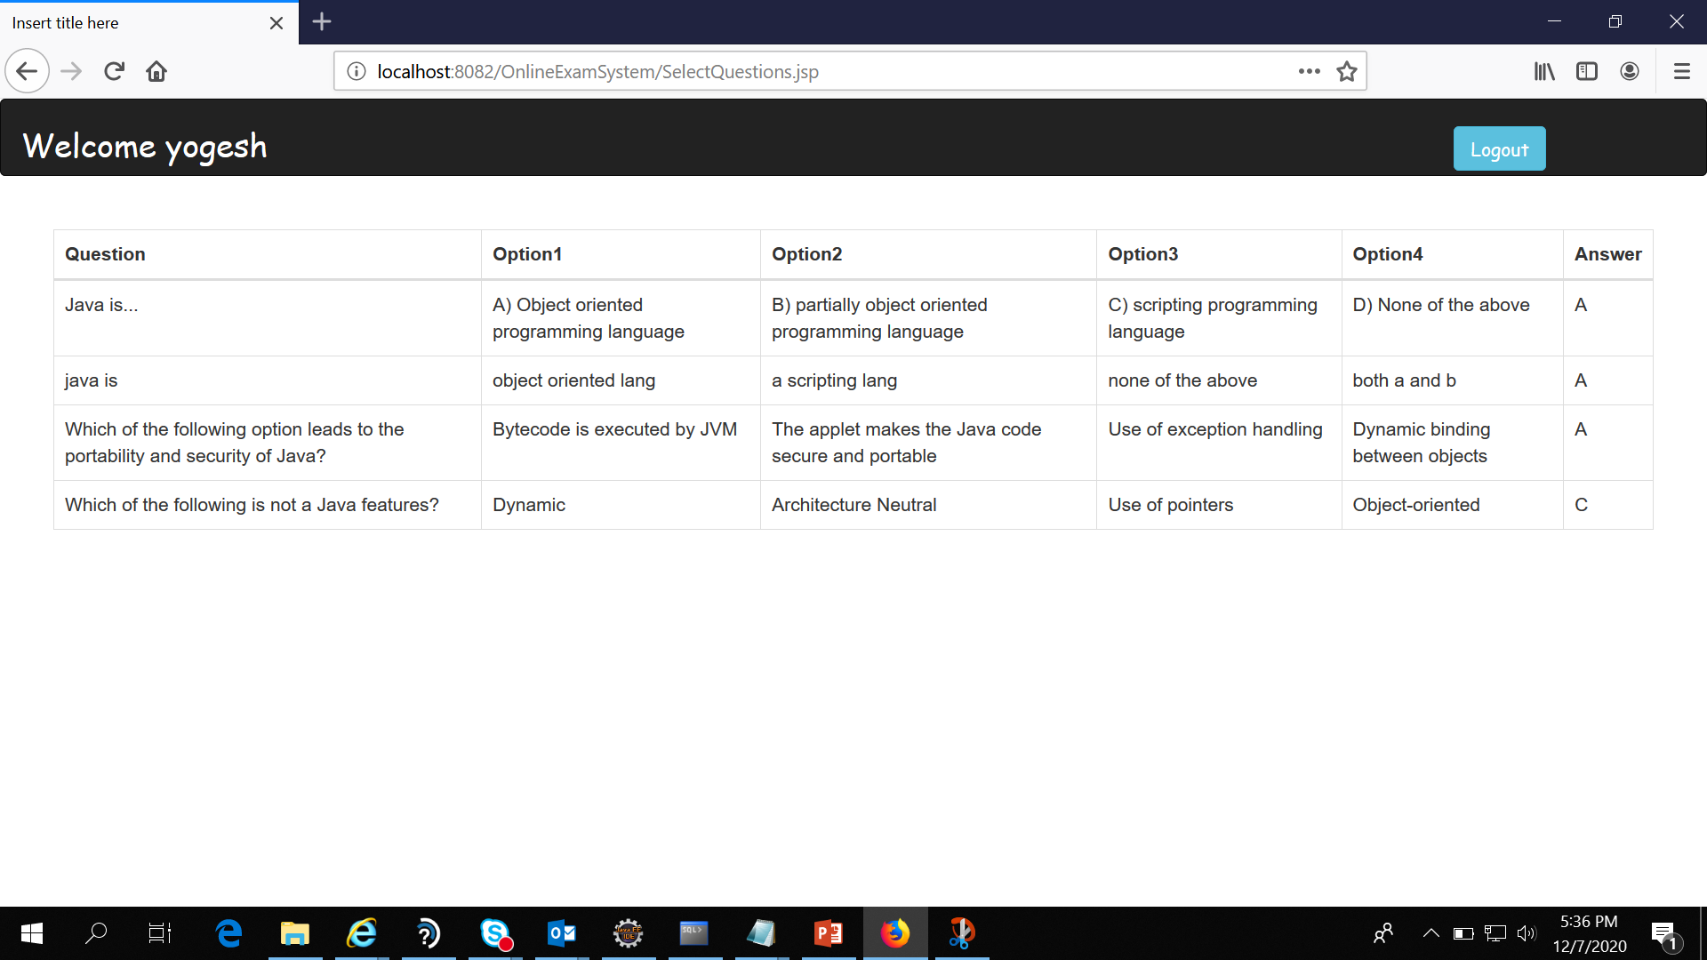
Teacher can see questions and answers

Slide 9
Thank you

